Slide 1
APPLIED DATA SCIENCE WORKSHOP SERIES
Data Visualization
for Decision
Makers
Presenter : Terri-Ann Grant
Data Science Graduate Specialist
Contact: terrianngrant@scarletmail.rutgers.edu
WEEK 3
Graduate Data Scientist | Applied Data Science Workshop

Slide 2
Workshop Goals
By the end of today's session, participants will be able to:
Understand principles of effective data visualization
Identify common visualization mistakes
Improve chart readability and storytelling
Communicate insights clearly to decision-makers
Create polished visualizations using Python
SESSION
OVERVIEW
WHY
Why Visualization Matters
CHT
Chart Selection
EDA
Case Study: NJ Data
LAB
Hands-On Practice
STR
Storytelling & Insight

Slide 3
Why Visualization Matters
Turning data into decisions
VISUALIZATION HELPS:
KEY POINT
1
Simplify complex information
VIZ
2
Reveal patterns quickly
3
Improve understanding
Visualization is not decoration.
4
Support faster decision-making
It is a communication tool.
5
Communicate to technical and non-technical audiences
Charts convey meaning that tables cannot.

Slide 4
What Makes a Good Visualization?
Six principles every analyst should apply
Clear Titles
Readable Labels
Right Chart Type
TTL
Tell the reader exactly what the chart shows.
LBL
Axis labels and legends that are easy to interpret.
CHT
Match the chart to the question being answered.
Minimal Clutter
Focused Messaging
Consistent Scales
CLN
Remove gridlines, borders, and decorations that add no value.
MSG
One chart, one key insight. Avoid overloading the viewer.
SCL
Axes should start at zero. Avoid misleading truncation.

Slide 5
Common Visualization Mistakes
Pitfalls that undermine your message
Overcrowded Charts
Missing Labels
CRW
Too many data series, categories, or labels make charts unreadable.
LBL
Axes without labels force the reader to guess what the data represents.
Inconsistent Scales
Too Many Colors
SCL
Truncated axes or dual axes can distort the apparent relationship.
CLR
Using a different color for every category reduces clarity, not improves it.
Wrong Chart Type
Lack of Context
TYP
A pie chart with 12 slices, or a bar chart for continuous data, sends the wrong signal.
CTX
A chart without interpretation leaves the reader to draw their own conclusions.

Slide 6
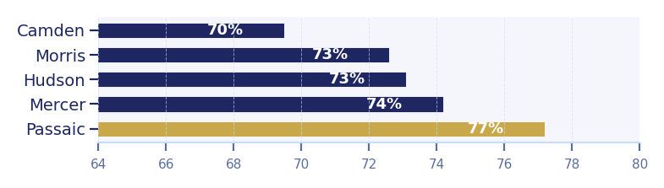
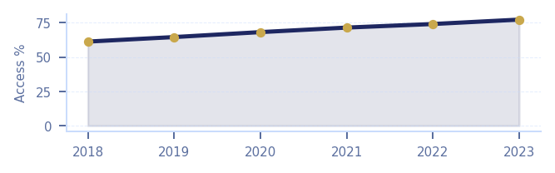
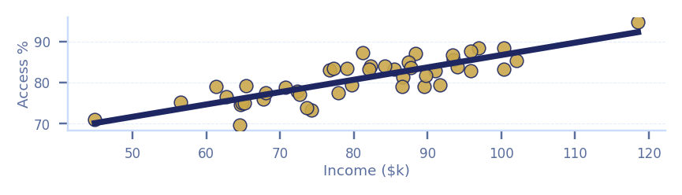
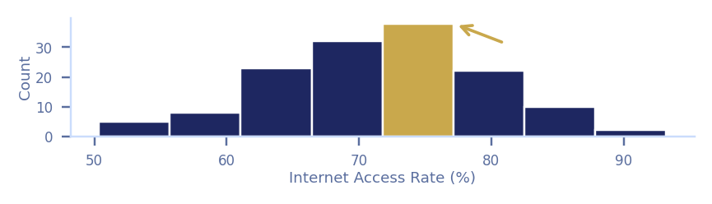
Choosing the Right Chart
Match the visual to the analytical question
BAR
Bar Charts
KEY IDEA
Comparing categories
Line Charts
Q?
LIN
Trends over time
SCT
Scatterplots
Relationships between variables
The chart should match the analytical question.
HIS
Histograms
Distributions
Start with the question,
then choose the visual.
MAP
Maps
Geographic patterns
Never the other way around.

Slide 7
Case Study: Digital Inequity in New Jersey
Applying visualization to a real-world dataset
WORKSHOP DATASET FOCUS
WHY THIS MATTERS
Participants will explore:
Digital inequity affects:
01
Broadband access disparities
EDU
Education
02
Income and internet access relationships
EMP
Employment
03
Community-level differences
HLT
Healthcare
04
Patterns associated with digital inequity
ECO
Economic Opportunity

Slide 8
Hands-On Activities
Today's collaborative notebook exercise
TODAY'S ACTIVITIES
TOOLS
1
Load and review the dataset
Matplotlib
Core charting library
2
Identify missing values and outliers
Seaborn
3
Detect placeholder codes such as 666666
Statistical visualizations
4
Improve poor visualizations
Pandas
Data wrangling
5
Create annotated charts
Google Colab
6
Extract and communicate insights
Collaborative notebook

Slide 9
From Visualization to Storytelling
Charts are the start, not the end
What does the chart reveal?
Why does this pattern matter?
REV
WHY
What action could result?
What additional information would help?
ACT
ADD
KEY POINT
Good analysis includes both visuals and interpretation.

Slide 10
Visualization Best Practices
Recommendations for clear, effective charts
Keep It Simple
Descriptive Titles
SMP
Charts should be immediately readable. Remove anything that doesn't add meaning.
TTL
Use the title to state the insight, not just describe the data.
Highlight Findings
Avoid Clutter
HGH
Use color or annotation to draw the reader's eye to what matters.
CLN
Fewer gridlines, fewer colors, and less decoration improve readability.
Design for Audience
Add Context
AUD
Decision-makers need clarity; technical peers may want more detail.
CTX
Label key data points and include a brief interpretive note.

Slide 11
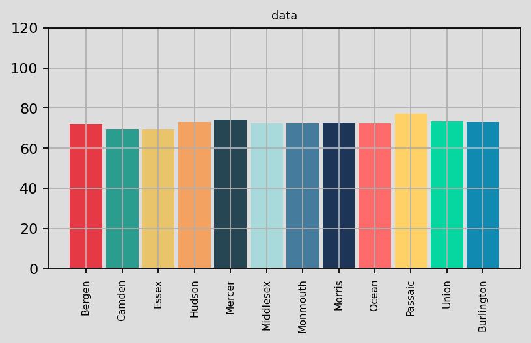
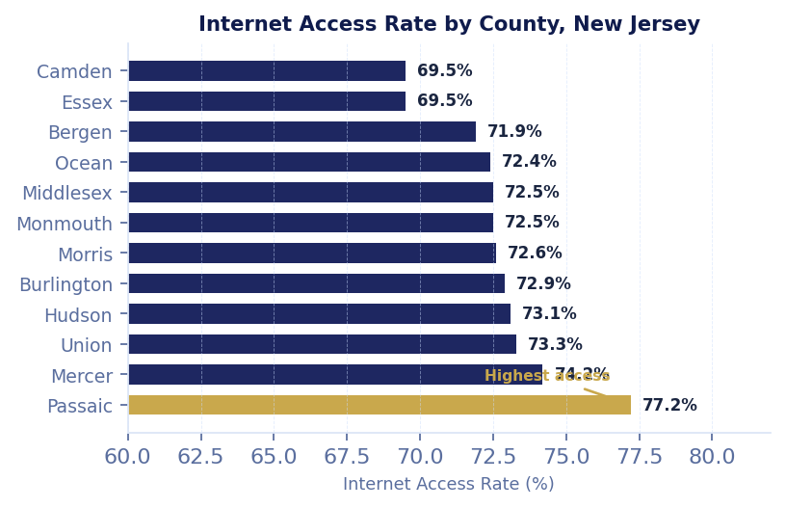
Chart Makeover: Before and After
The same data -- two very different messages
BAD
BEFORE
GOOD
AFTER
>
WHAT IMPROVED
1
Descriptive title states the finding
2
Focused scale (60-82%) shows real variation
3
Sorted bars reveal patterns at a glance
4
Single colour + gold highlight removes distraction

Slide 12
Key Takeaways
01
Visualization supports communication and understanding
02
Real-world datasets contain imperfections that must be managed
03
Good visuals improve decision-making
04
Storytelling is a critical analytical skill
Data Visualization for Decision Makers | Applied Data Science Workshop Series | Week 3

